Slide 1
WORK WITH MODEL RELATIONSHIPS
BY NITIN

Slide 2
OBJECTIVES
I learned the working and usage of solid line represents an active relationship and a dotted line represents an inactive relationship.
The lab emphasizes proper relationship cardinality and direction to ensure accurate Power BI visuals.

Slide 3
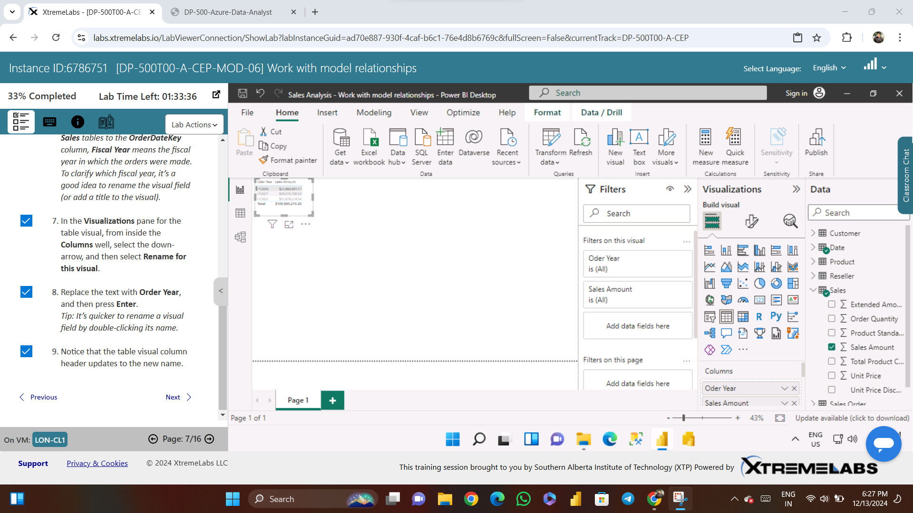

Slide 4
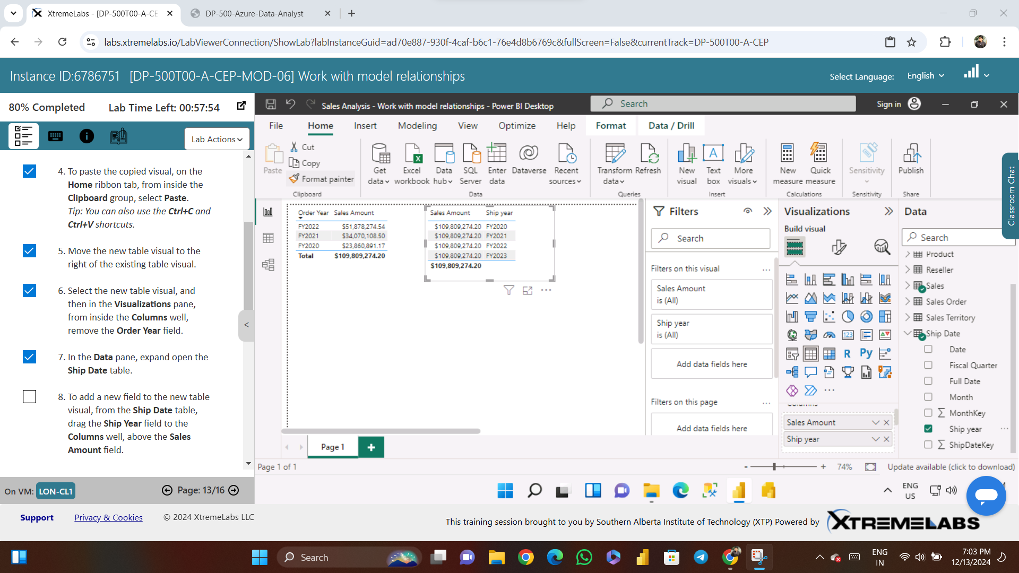

Slide 5
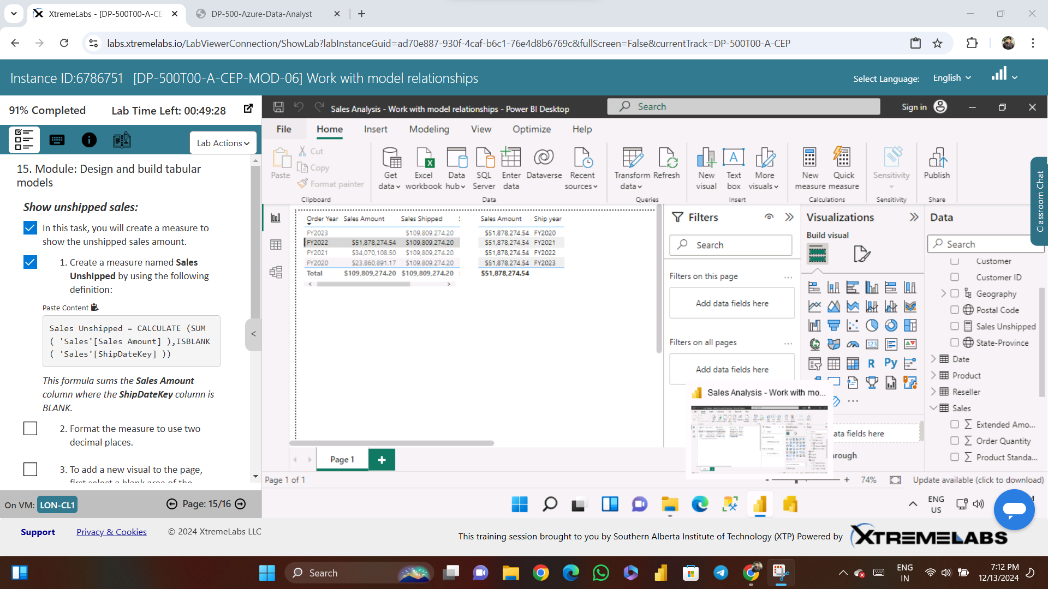

Slide 6
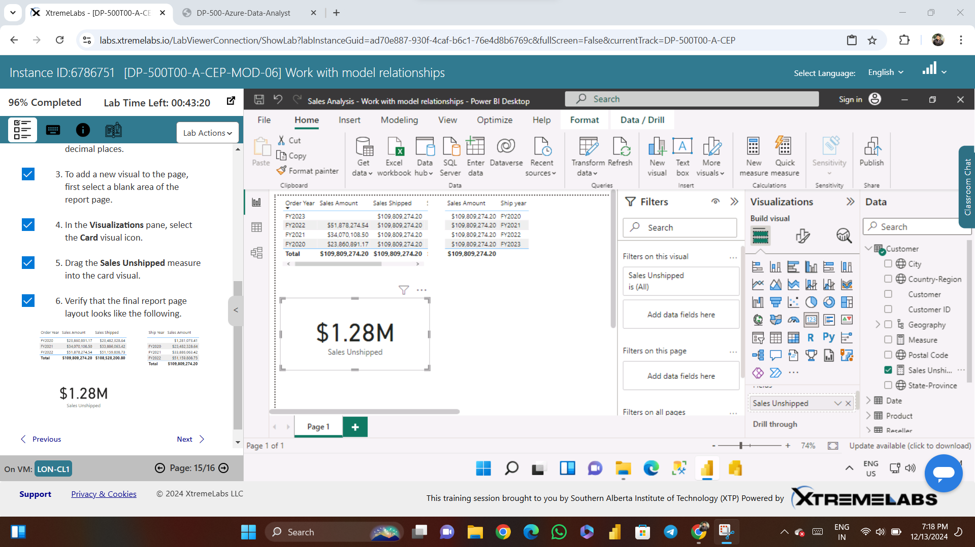

Slide 7
